Slide 1

Co Smart Supply Chain | Azure Data Engineering project presented by : SHR1_AIS4_M1d TEAM

Slide 2
Project Overview :
This presentation outlines an end-to-end Azure data engineering project for extracting, transforming, and loading Co Smart Supply Chain Dataset, enabling insightful analysis and visualizations.

Slide 3
UNDERSTANDING THE PROBLEM

Slide 4
UNDERSTANDING THE PROBLEM
Data scope
Goal
The dataset encompasses detailed information about Co Smart Supply Chain Dataset, containing information about over 180,500 record for customers , their orders , products and sales .
Our goal build data pipeline to analyze the dataset to uncover valuable insights and understand the dataset.

Slide 5
Project Objectives
01
02
03
Data Pipeline
Insights
Azure Tools
Construct a data pipeline using Azure tools for processing and analyzing the Co Smart Supply Chain Dataset
Gain valuable insights from the dataset, understanding Provisioning , Production , Sales , Commercial Distribution from dataset.
Develop proficiency in using key Azure tools like Azure Data Lake Storage, Azure Data Factory, and Azure Synapse Analytics.

Slide 6
About Data
We aim to extract insights from the Co Smart Supply Chain Dataset, containing information about over 180,500 record for customers , their orders ,order items , location , products and sales , and the data is csv raw data file .

Slide 7
OUR SOLUTIONS
using Azure tools to build a data pipeline to Co Supply Chain Data .
Data Extraction
Data Transformation
use Azure Data Factory to extract data from SQL database
Azure Databricks will be used to transform the extracted data using Spark code
Data loading
Data Analysis
The transformed data will be loaded into Azure Data Lake Storage.
Azure Synapse Analytics will be used to analyze the data using SQL queries.

Slide 8
OUR SOLUTIONS
using Azure tools to build a data pipeline to Co Supply Chain Data .
Data Transformation
Data Extraction
Azure Databricks will be used to transform the extracted data using Spark code
use Azure Data Factory to extract data from SQL database
Data loading
Data Analysis
The transformed data will be loaded into Azure Data Lake Storage.
Azure Synapse Analytics will be used to analyze the data using SQL queries.

Slide 9


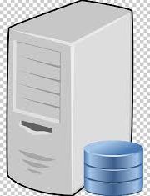





We will first design a data pipeline that outlines the steps involved in extracting, transforming, and loading the data.
Transforming
Azure Databricks
Ingestion
Reporting
Data Warehouse
Data Source
Azure SQL Database
Azure Synapse Analytics
Sql Server Database
Azure Data Factory
Azure Data Lake Gen2
Power pi
Project Architecture

Slide 10
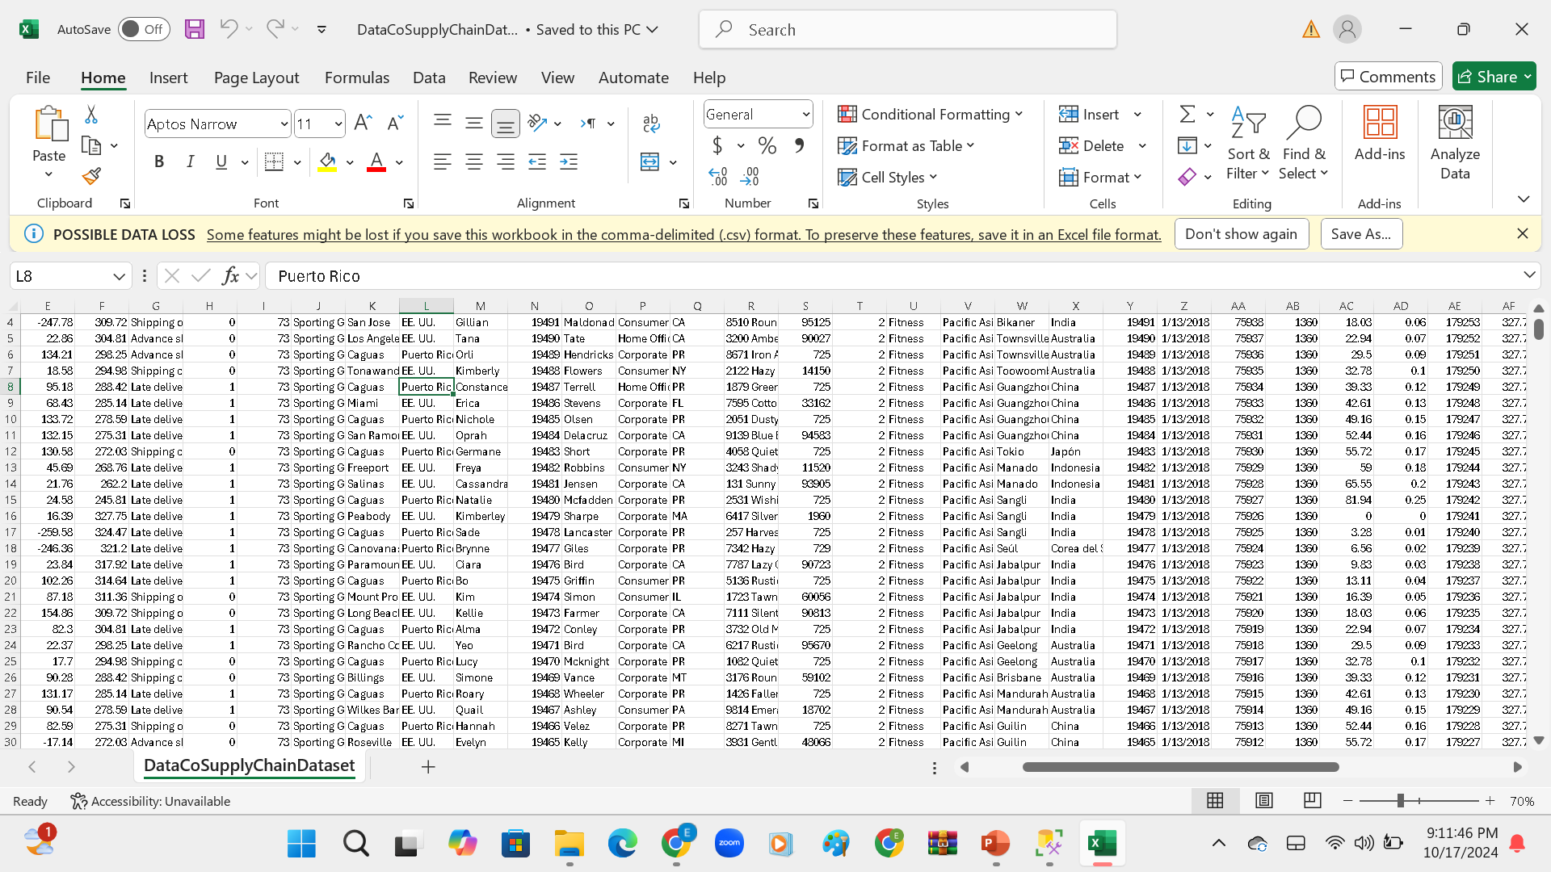
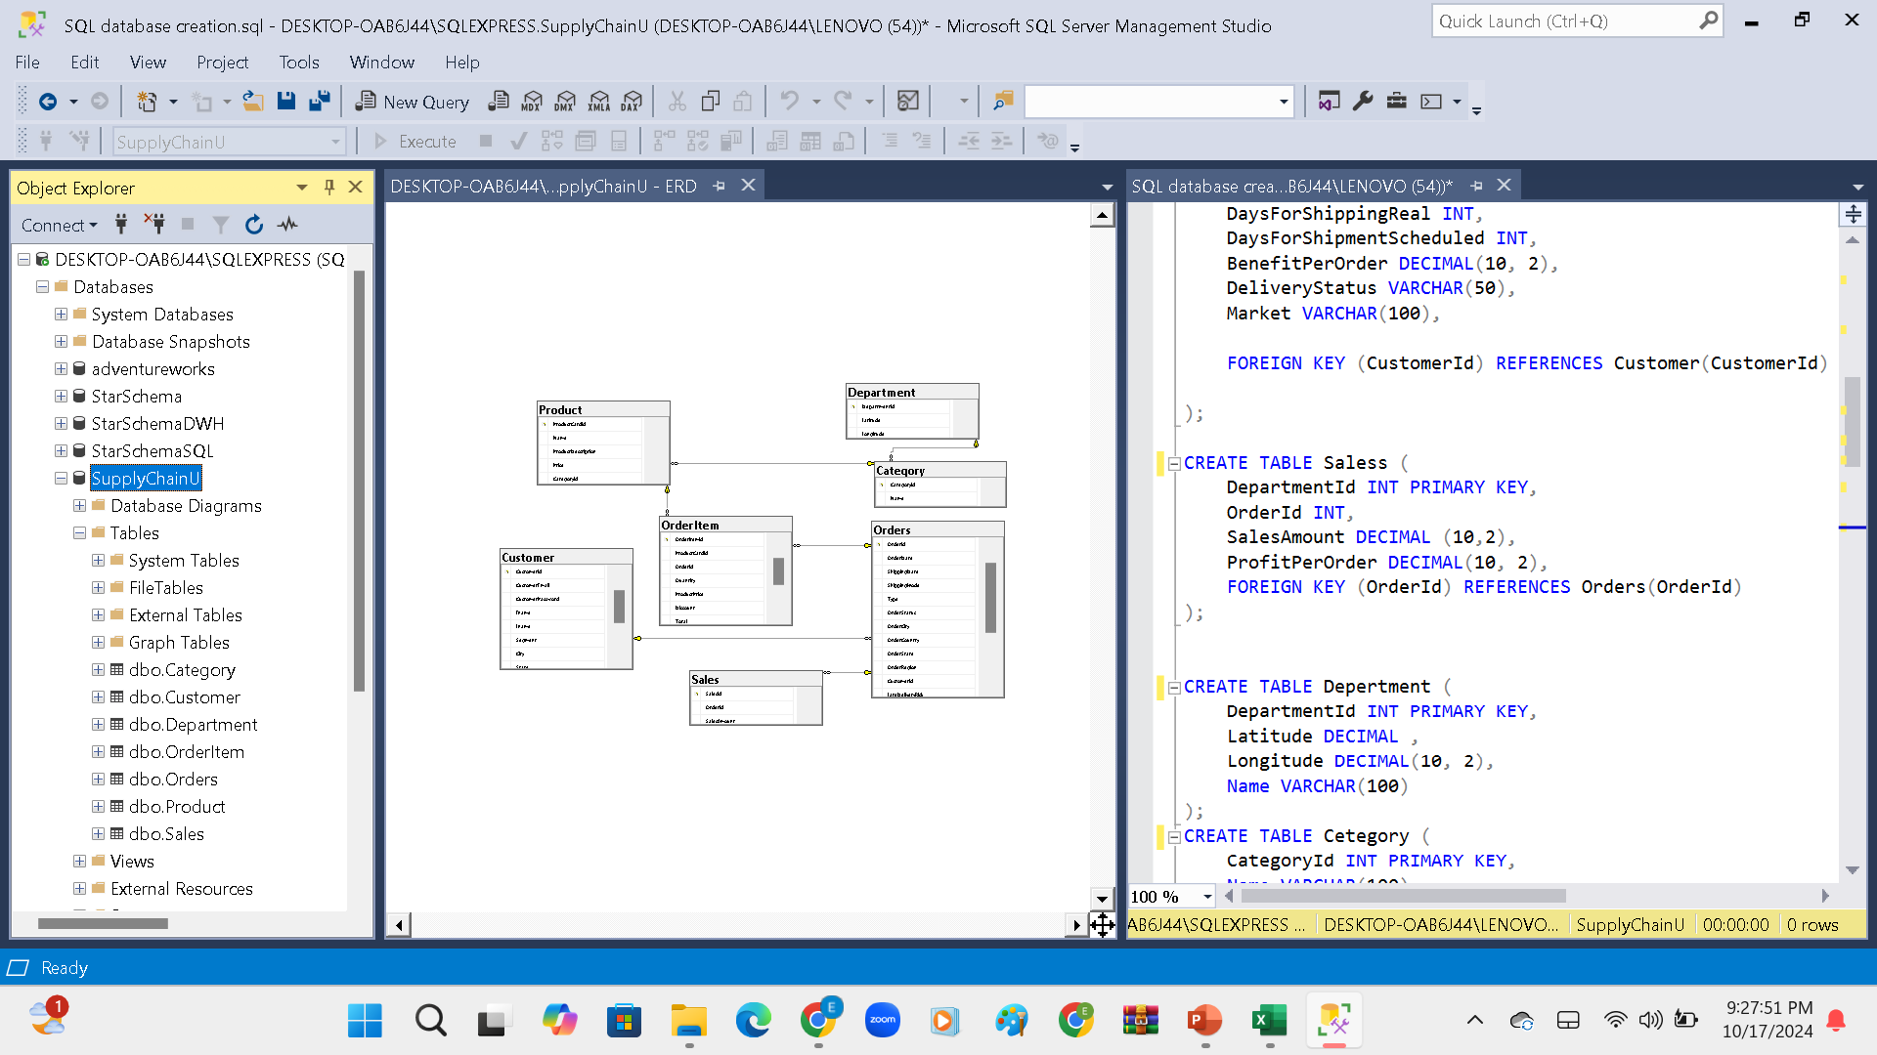
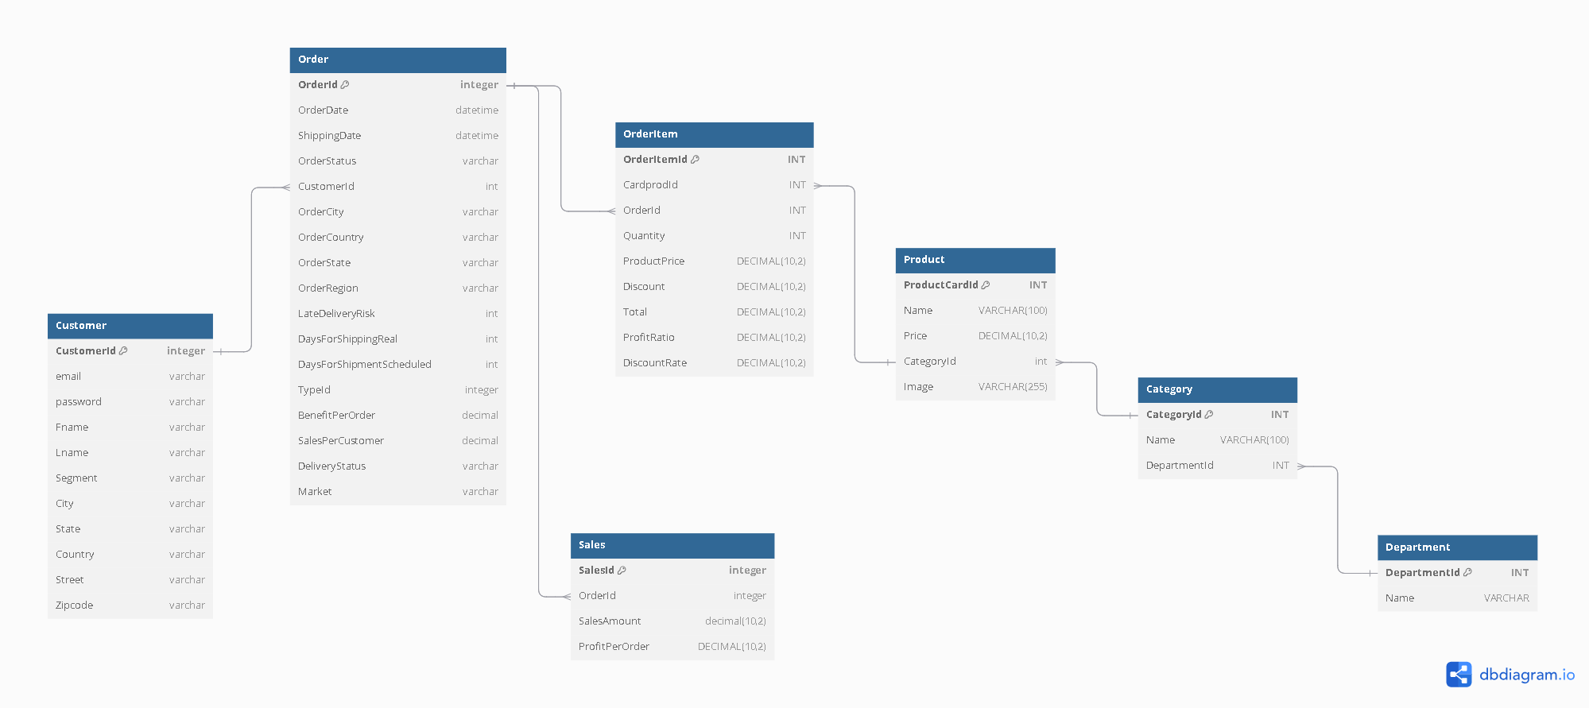
we have raw csv data file , and the description of each column .
creating local SQL database using sql server management studio .
ER diagram for dataset .
Project implementation

Slide 11
we have raw csv data file , and the description of each column .
ER diagram for dataset .
creating local SQL database using sql server management studio .
Project implementation

Slide 12
creating local SQL database using sql server management studio .
ER diagram for dataset .
we have raw csv data file , and the description of each column .
Project implementation

Slide 13
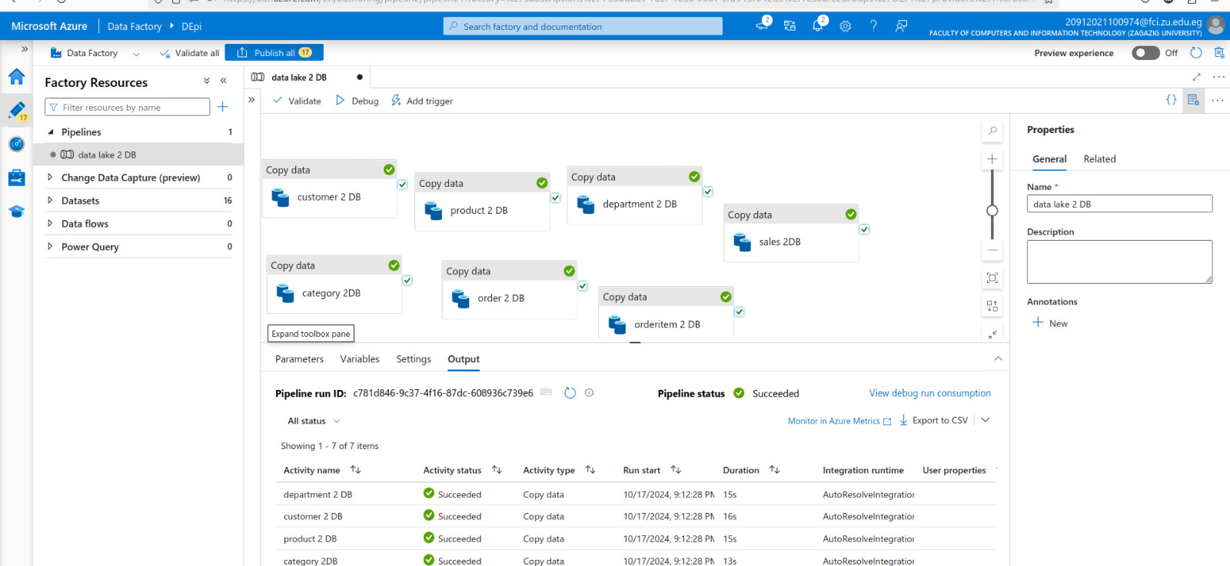
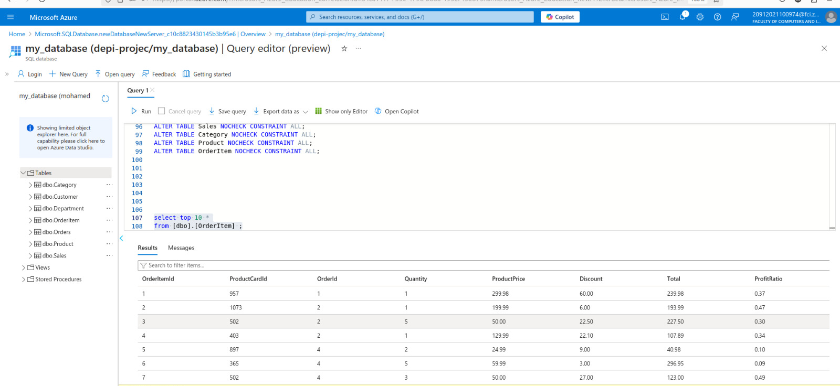
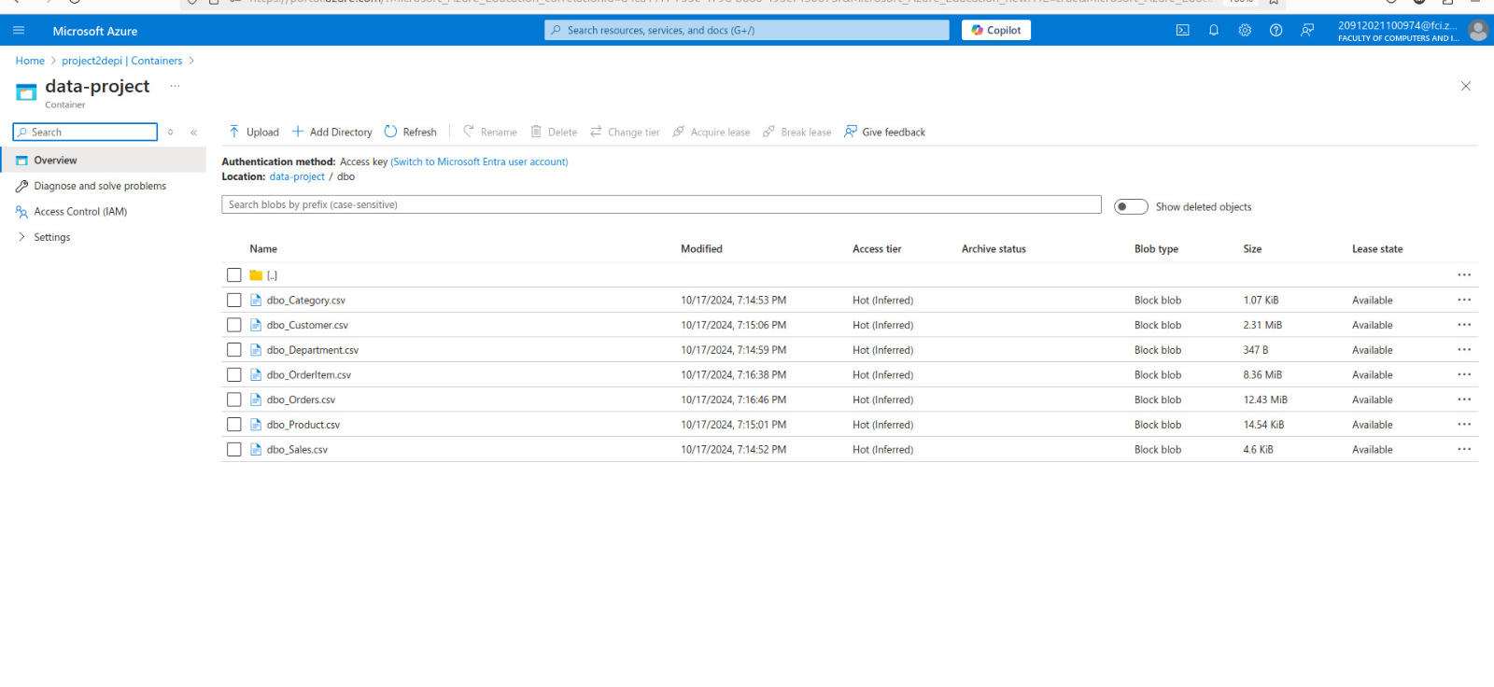
From data lake gen 2 to DB .
Data lake gen 2.
Project implementation

Slide 14
From data lake gen 2 to DB .
Data lake gen 2.
Project implementation

Slide 15
From data lake gen 2 to DB .
Data lake gen 2.
Project implementation

Slide 16
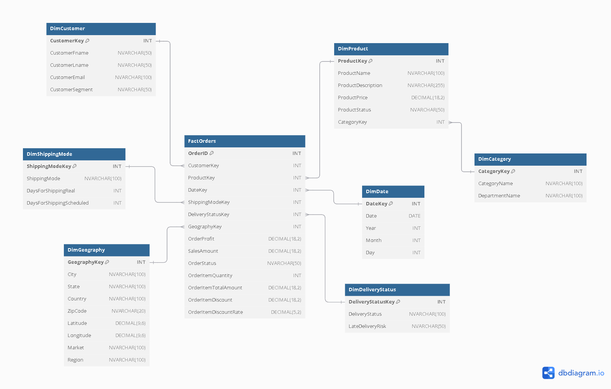
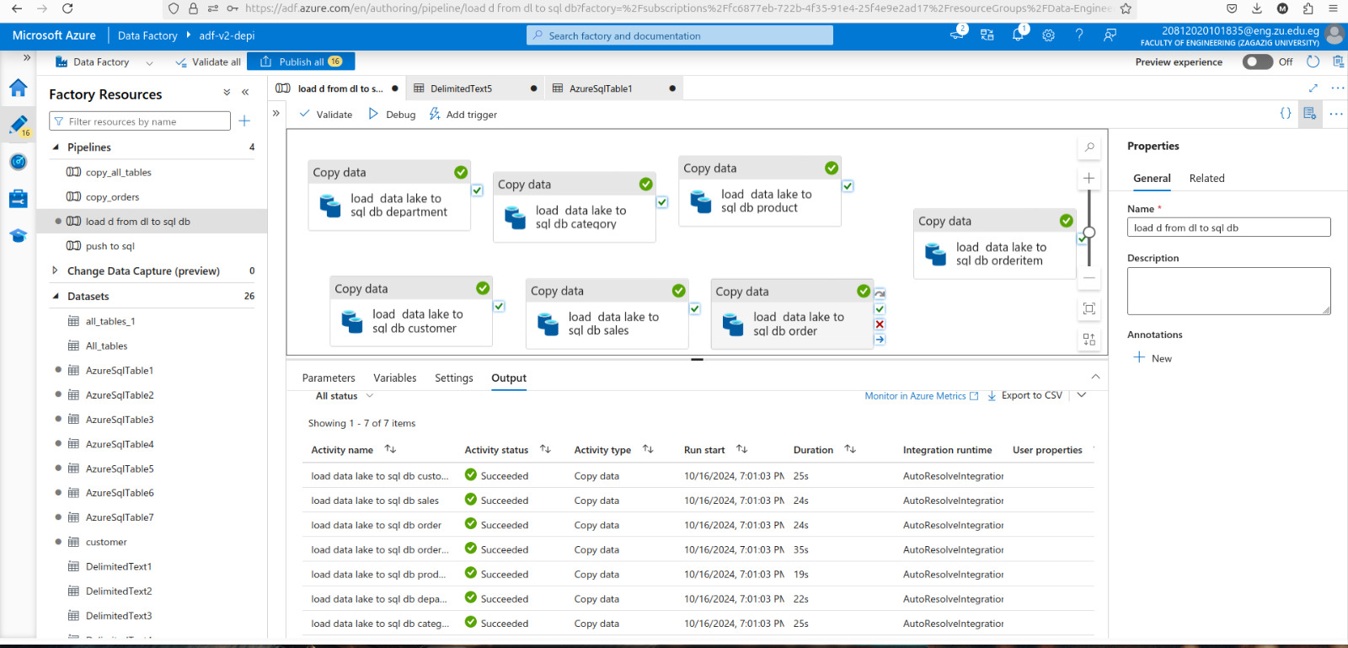
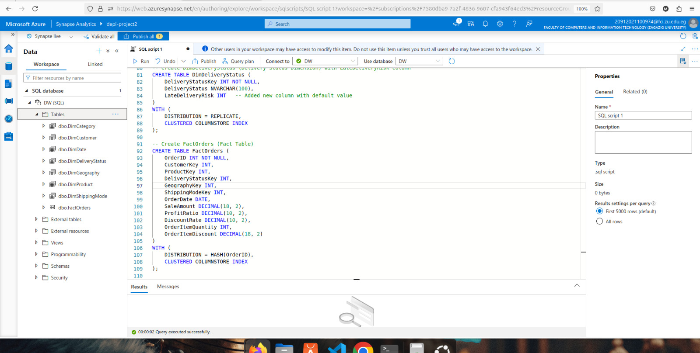
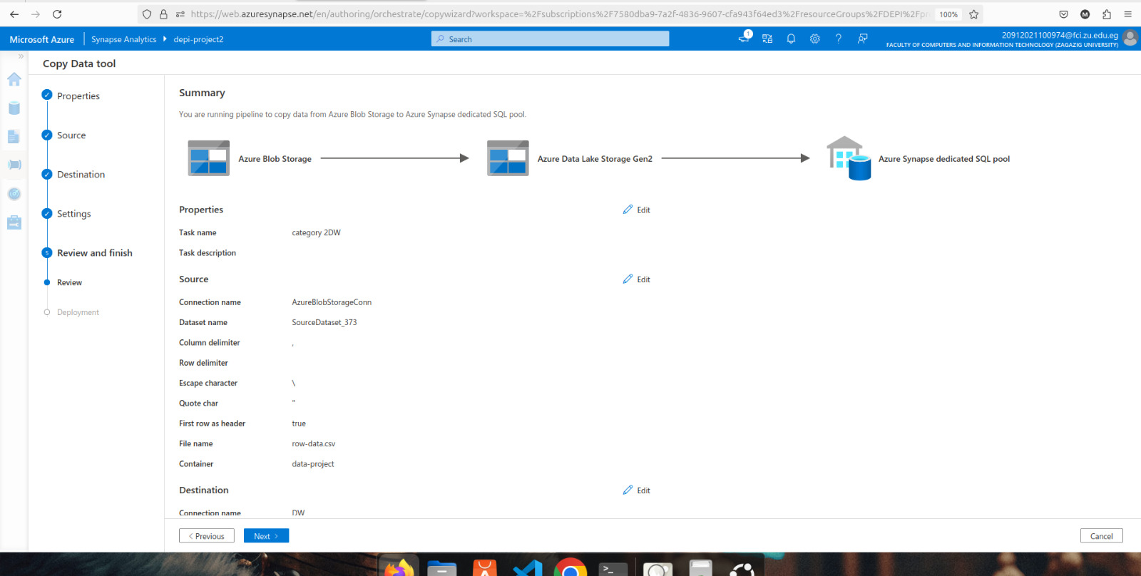
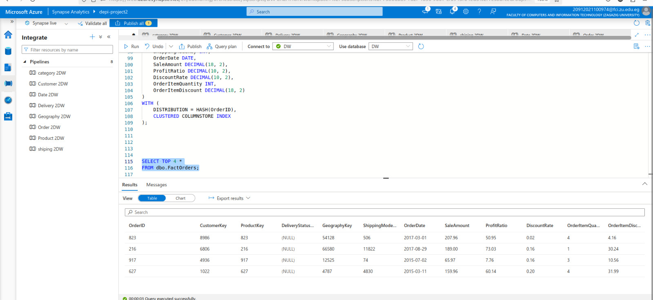
DWH schema.
DWH.
Azure Synapse Analytics.
Azure Synapse Analytics.
Project implementation

Slide 17
DWH.
DWH schema.
Azure Synapse Analytics.
Azure Synapse Analytics.
Project implementation

Slide 18
Azure Synapse Analytics.
DWH schema.
Azure Synapse Analytics.
DWH.
Project implementation

Slide 19
Azure Synapse Analytics.
DWH schema.
Azure Synapse Analytics.
DWH.
Project implementation

Slide 20
Azure Synapse Analytics.
DWH schema.
DWH.
Azure Synapse Analytics.
Project implementation

Slide 21
Azure Synapse Analytics.
Project implementation

Slide 22
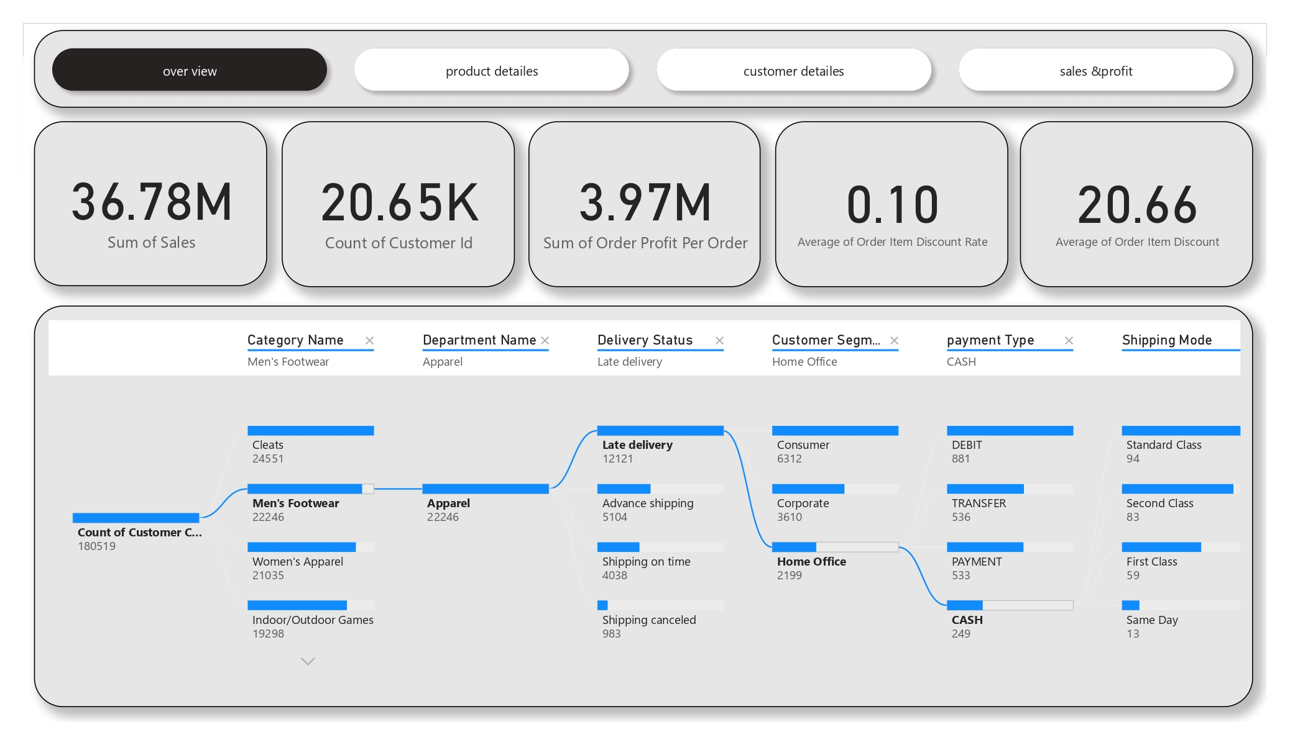
USING BOWER PI
Data Visualization

Slide 23
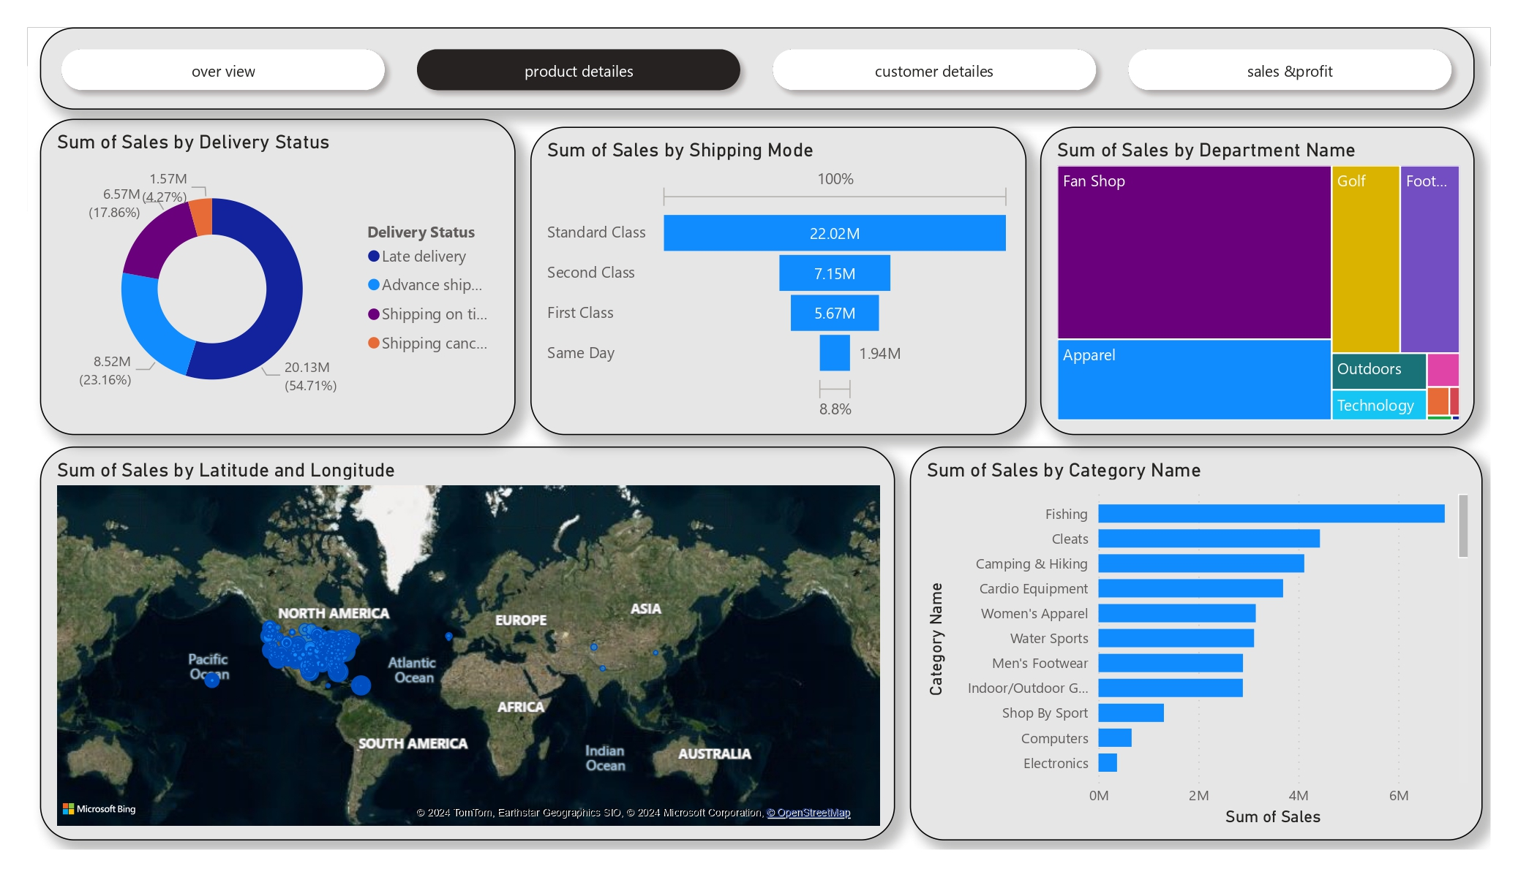
USING BOWER PI
Data Visualization

Slide 24
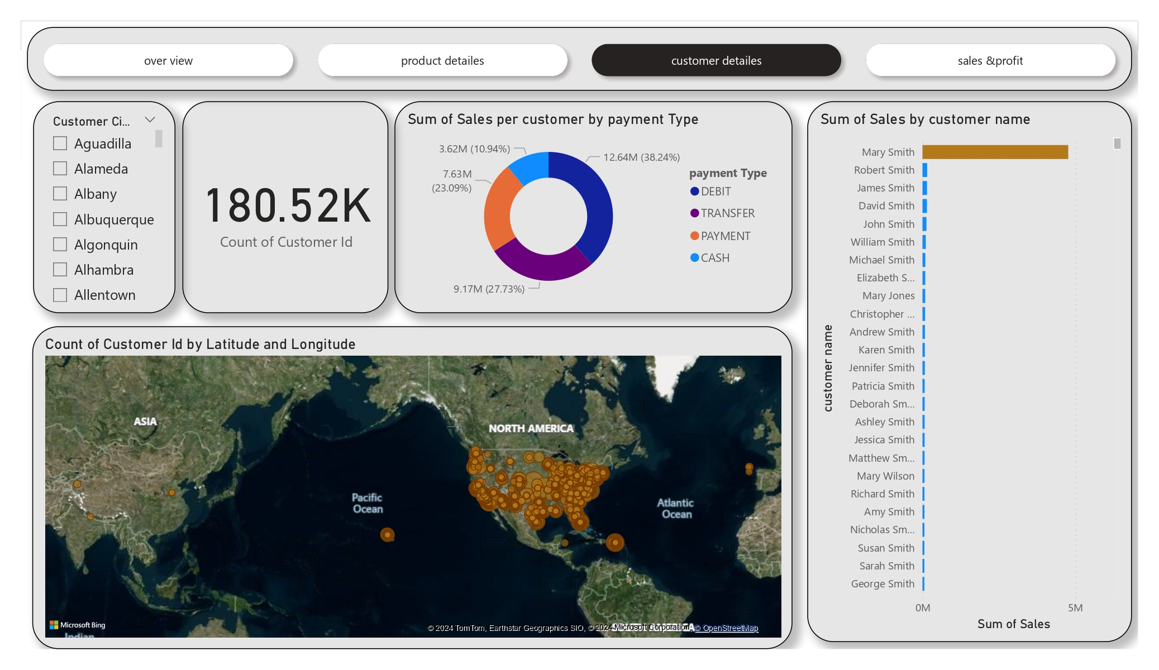
USING BOWER PI
Data Visualization

Slide 25
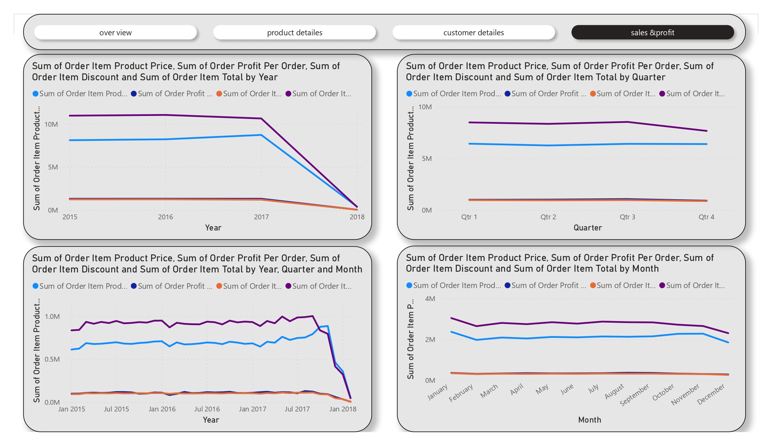
USING BOWER PI
Data Visualization

Slide 26
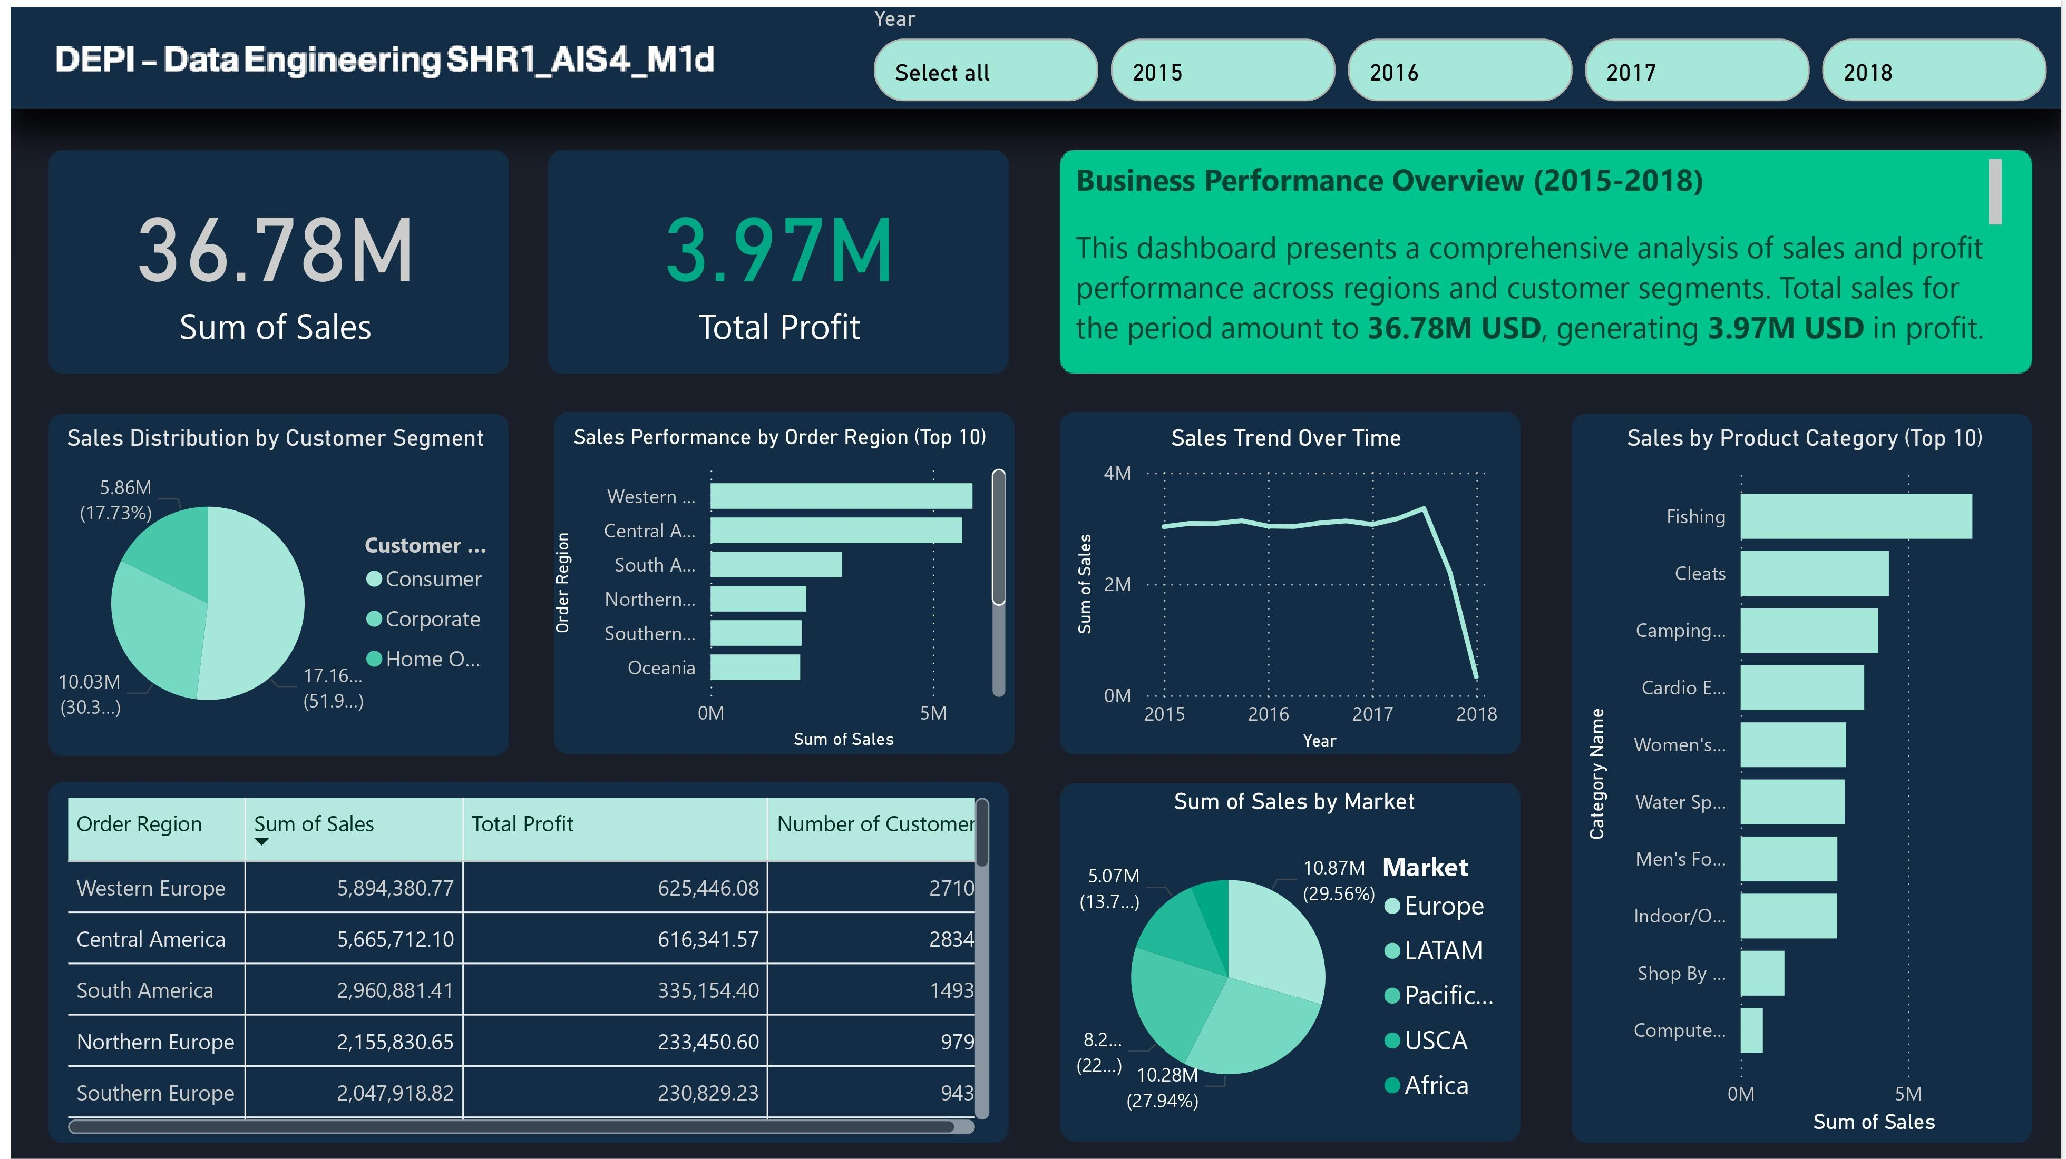
Data Visualization

Slide 27
Thank you

